Slide 1







Unit – 7
I/O Management & Disk Scheduling
3140702
Operating System
Subject Faculty: Prof. Suhag Baldaniya
Unit- 7 I/O Management & Disk Scheduling (Prof. Aanchal Phutela)

Slide 2
Disclaimer
It is hereby declared that the production of the said content is meant
for non-commercial, scholastic and research purposes only.
We admit that some of the content or the images provided in this channel's videos may be obtained through the routine Google image searches and few of them may be under copyright protection. Such usage is completely inadvertent.
It is quite possible that we overlooked to give full scholarly credit to the Copyright Owners. We believe that the non-commercial, only-for- educational use of the material may allow the video in question fall under fair use of such content. However we honor the copyright holder's rights and the video shall be deleted from our channel in case of any such claim received by us or reported to us.

Slide 3
Topics to be covered
I/O Management
Principles of I/O Hardware:
I/O devices
Device controllers
Direct memory access
Secondary-Storage Structure:
Disk structure
Disk scheduling algorithm

Slide 4




Principles of I/O Hardware: I/O device
storage devices (disks, tapes)
Computers operate a great many kinds of devices. Most fit into the general categories:
transmission devices (network
cards, modems)
human-interface devices (screen, keyboard, mouse).

Slide 5
Principles of I/O Hardware: I/O device
Two types of I/O
devices
block, character
It is one that stores information in fixed-size
blocks each one with its on address.
can read blocks independently another
Hard disks, CD-ROMs, USB sticks
512 bytes to 32,768 bytes
of one
Block device:
accepts characters without regard to block
structure
Printers, mouse, network interfaces
Character device:
Not everything fits:
e.g. clocks don’t fit

Slide 6
Components of I/O devices
I/O devices have two components
Mechanical component - Device itself.
Electronic Component-
Known as device controller or adapter .
The controller card usually has a connector on it, into which a cable leading to the device itself can be plugged

Slide 7
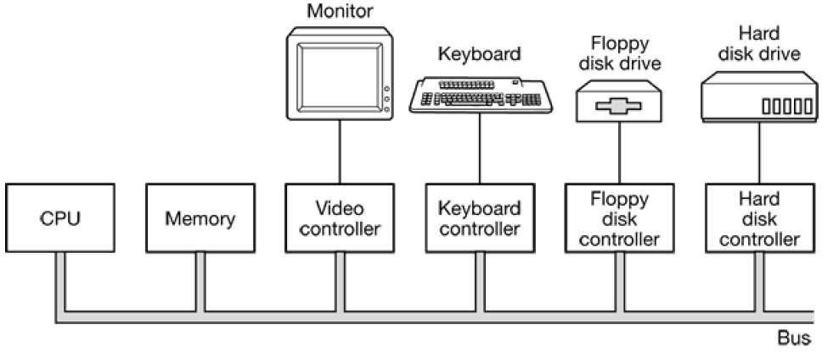
Device Controller

Slide 8
Device Controller
Electronic component which controls the device.
It may handle multiple devices.
There may be more than one controller per mechanical component (example: hard drive).
Controller's tasks are:
It converts serial bit stream to block of bytes
Perform error correction if necessary
Block of bytes is first assembled bit by bit in buffer inside the
controller
After verification, the block has been declared to be error free, and then it can be copied to main memory

Slide 9
Device Controller
Each device controller has a few registers that are used for communicating with the CPU.
By writing into these registers, the OS can command the device to deliver data, accept data, switch itself on or off, or perform some action.
By reading from these registers OS can learn what the device’s status is, whether it is prepared to accept a new command and so on.
There are two ways to communicate with control registers and the device buffers:
I/O Port
Memory mapped I/O

Slide 10
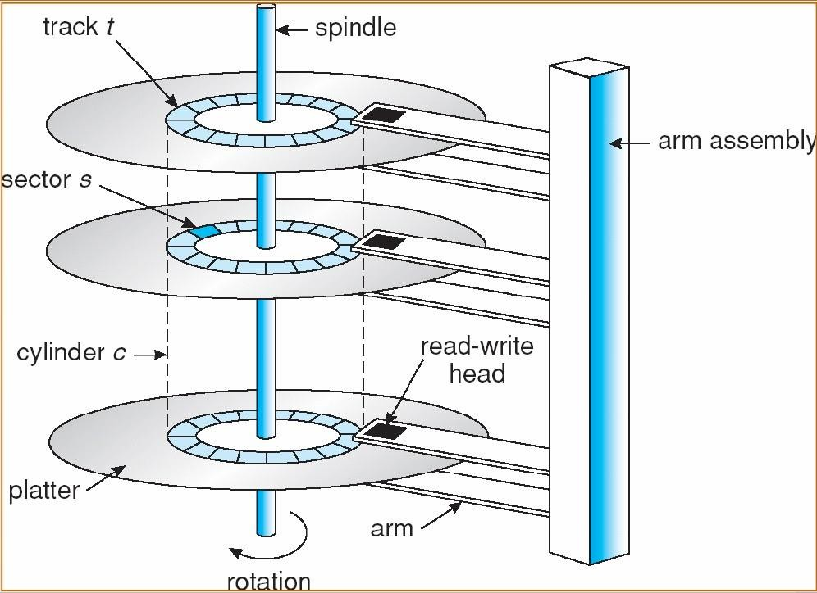
Disk Architecture
Platter → Surface → Track → Sector → Data .
8*2*256*512*512
2(3)*2(1)*2(8)*2(9)
2(40)
1TB
KB
*2(9)2(10)

Slide 11
Disks
It is relatively permanent and can hold large quantities of data. Its access time is slow compared with that of main memory and magnetic disk. provide the bulk of secondary storage for modern computer system.
disk platter: has a flat circular shape, like a CD. The two surfaces of a platter are covered with a magnetic material. We store information by recording it magnetically on the platters.
The surface of a platter is logically divided into circular tracks which are subdivided into sectors. The set of tracks that are at one arm position makes up a cylinder.

Slide 12
Disk Access time
Seek time – the time taken by r/w head to reach desired track.
Rotation time – the time for one full rotation (360◦).

Slide 13




How does CPU communicate with registers and buffers?
If CPU want to read word,
Puts read SIGNAL on control line
Put address on address line
A second signal line is used to tell weather I/O space or memory space is needed.
First scheme
Memory mapped approach
If CPU want to read word,
Puts read SIGNAL on control line
Put address on address line and let memory module and I/O devices compare address with the ranges they serve.

Slide 14
Memory Mapped I/O
Advantages:
As the I/O space is mapped into memory so no need of any special instructions to read/write control register, can write a device driver in C
Don’t need special protection to keep users from doing I/O directly. Just don’t put I/O memory in any user space.
Disadvantages:
If there is only one address space, then all memory modules and all I/O devices must examine all memory references to see which ones to respond to.
solution: A dual-bus memory

Slide 15
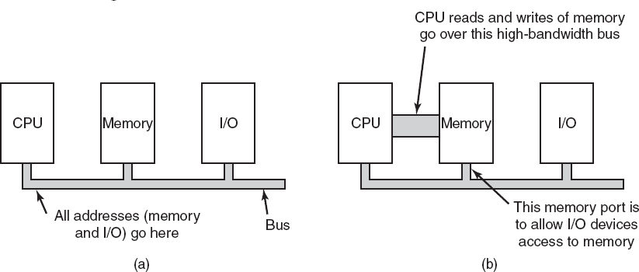
Memory-Mapped I/O
(a) A single-bus architecture. (b) solution: A dual-bus memory architecture.

Slide 16
Direct Memory Access
CPU could request data one byte at a time from I/O controller, Big waste of time. So other schema can be used DMA.
DMA controller can access system bus independent of CPU. DMA contains serval registers that can be written and read by CPU.
Memory address register
Byte count register
Control registers-I/O port, direction of transfer, transfer units
(byte/word), number of bytes to transfer in a burst.
▪
▪
▪

Slide 17
How Disk read occurs when DMA is not used??
First the controller reads the block (one or more sectors) from the drive serially, bit by bit, until the entire block is in the controller’s internal buffer.
Next, it computes the checksum to verify that no read errors have occurred. Then the controller causes an interrupt.
When the operating system starts running, it can read the disk block from the controller’s buffer a byte or a word at a time by executing a loop, with each iteration reading one byte or word from a controller device register and storing it in main memory.

Slide 18
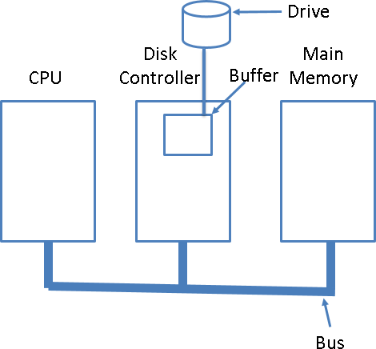
How Disk read occurs when DMA is not used??

Slide 19

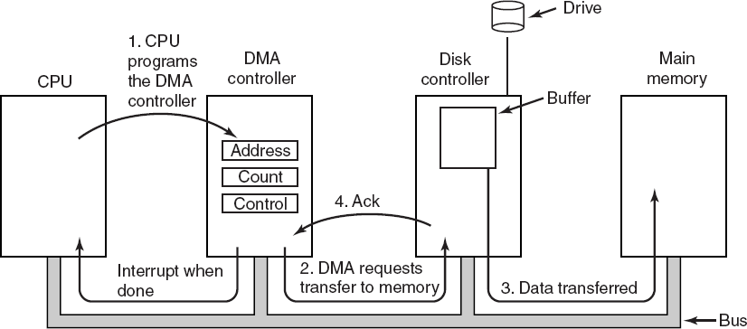
How does DMA work?

Slide 20
How does DMA work?
Step 1: First the CPU programs the DMA controller by setting its registers so it knows what to transfer where.
It also issues a command to the disk controller telling it to read data from the disk into its internal buffer and verify the checksum. When valid data are in the disk controller’s buffer, DMA can begin.
Step 2: The DMA controller initiates the transfer by issuing a read request over the bus to the disk controller.
This read request looks like any other read request, and the disk controller does not know (or care) whether it came from the CPU or from a DMA controller.

Slide 21
How does DMA work?
Typically, the memory address to write to is on the bus’ address lines, so when the disk controller fetches the next word from its internal buffer, it knows where to write it.
Step 3: The write to memory is another standard bus cycle.
Step 4: When the write is complete, the disk controller sends an acknowledgement signal to the DMA controller, also over the bus.
The DMA controller then increments the memory address to use and decrements the byte count.
If the byte count is still greater than 0, steps 2 to 4 are repeated
until it reaches 0.
21

Slide 22
Modes of bus operation
The buses can be operated in two modes
Word-at-a-time mode: Here the DMA requests for the
transfer of one word and gets it.
If CPU wants the bus at same time then it has to wait.
This mechanism is known as Cycle.
Block mode: Here the DMA controller tells the device to acquire the bus, issues a series of transfer and then releases the bus.
This form of the operation is called Burst mode.
It is more efficient then cycle stealing.

Slide 23
Disk Arm Scheduling Algorithm
Various types of disk arm scheduling algorithms are available to decrease mean seek time.
FCFS (First come first serve)
SSTF (Shorted seek time first)
SCAN
C-SCAN
LOOK (Elevator)
C-LOOK

Slide 24
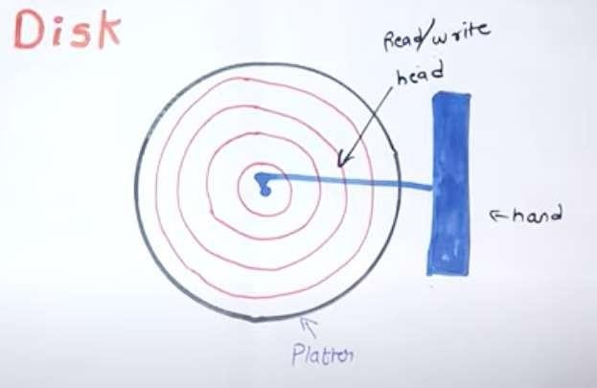

Slide 25





FCSC (First come first serve)
Here requests are served in the order of their arrival.
0 1 9 12 16 34 36
50
1
11
34
1,
36,
16,
34,
9,
12
36
16
9
12
Disk movement will be 11, 1, 36, 16, 34, 9 and 12.
Total cylinder movement: (11-1) + (36-1) + (36-16) + (34-16) + (34-9) +
(12-9) = 111

Slide 26
Disk Scheduling Algorithm
Q1 Track no given= 82, 170,43,140,24,16,190
A disk contains 0-199 tracks
Current position of r/w head is 50
Calculate the total no of track movement of your r/w head? Solution-
FCFS= and SSTF=
SCAN=
C-SCAN LOOK
C-LOOK

Slide 27






SSTF (Shortest seek time first)
We can minimize the disk movement by serving the request closest to the current position of the head.
0 12
16
1 9 34 36 50
1
11
12
34
1,
36,
16,
34,
9,
12
9
16
36
Disk movement will be 11, 12, 9, 16, 1, 34, 36.
Total cylinder movement: (12-11) + (12-9) + (16-9) + (16-1) + (34-1) +
(36-34) = 61

Slide 28
LOOK(Elevator)
Keep moving in the same direction until there are no more outstanding requests pending in that direction, then algorithm switches the direction.
After switching the direction the arm will move to handle any request on the way. Here first go it moves in up direction then goes in down direction.
This is also called as elevator algorithm.
In the elevator algorithm, the software maintains 1 bit: the current direction bit, which takes the value either UP or DOWN.

Slide 29






LOOK (Elevator)
0
1
9
12
16
34
36
50
11
1,
36,
16,
34,
9,
12
12
16
34
36
9
1
Disk movement will be 11, 12, 16, 34, 36, 9, 1.
Total cylinder movement: (12-11) + (16-12) + (34-16) + (36-34) + (36-9) +
(9-1)=60

Slide 30
Disk Scheduling Algorithm
Q1 Track no given= 82, 170,43,140,24,16,190
A disk contains 0-199 tracks
Current position of r/w head is 50 direction is towards larger value of track
Calculate the total no of track movement of your r/w head?
Solution-
FCFS=642 and SSTF=208 SCAN=
C-SCAN LOOK
C-LOOK

Slide 31
C-LOOK
Keep moving in the same direction until there are no more outstanding requests pending in that direction, then algorithm switches direction.
When switching occurs the arm goes to the lowest numbered cylinder with pending requests and from there it continues moving in upward direction again.

Slide 32

C-LOOK
0
1
9
12
16
34
36
50
11
1,
36,
16,
34,
9,
12
12
16
34
36
1
9
Disk movement will be 11, 12, 16, 34, 36, 1, 9.
Total cylinder movement: (12-11) + (16-12) + (34-16) + (36-34) +(36-
1)+(9-1)=68

Slide 33
SCAN
From the current position disk arm starts in up direction and moves towards the end, serving all the pending requests until end.
At that end arm direction is reversed (down) and moves towards the other end serving the pending requests on the way.

Slide 34




SCAN
0
1
9
12
16
34
36
50
1 | 9 | 11 | 12 | 16 | 34 | 36 50
1,
36,
16,
34,
9,
12
Disk movement will be 11, 12, 16, 34, 36, 50, 9, 1.
Total cylinder movement: (12-11) + (16-12) + (34-16) +(36-34) +(50-36) +
(50-9) + (9-1) = 88

Slide 35
C-SCAN
From the current position disk arm starts in up direction and moves towards the end, serving request until end.
At the end the arm direction is reversed (down), and arm directly goes to other end and again continues moving in upward direction.

Slide 36


C-SCAN
0
1
9
12
16
34
36
50
0 | 1 | 11 9 | 12 | 16 | 34 | 36 50
1,
36,
16,
34,
9,
12
Disk movement will be 11, 12, 16, 34, 36, 50, 0, 1,9.
Total cylinder movement: (12-11) + (16-12) + (34-16) +(36-34) +(50-36) +
(50-0) + (1-0)+ (9-1) = 98

Slide 37
Disk Scheduling Algorithm
Q- Track no given= 55,58,39,18,90,160,150,38,184
A disk contains 0-199 tracks
Current position of r/w head is 100 and direction is towards larger value of track
Calculate the total no of track movement of your r/w head for FCFS, SSTF, SCAN,C-SCAN, LOOK AND C-LOOK?

Slide 38
Disk Scheduling Algorithm
Solution FCFS=498 SSTF=248 SCAN= 280 C-SCAN=388 LOOK=250
C-LOOK=322

Slide 39
(RAID – Redundant Array of Independent Disks)
•Parallel processing is being used more and more to speed up CPU performance, parallel I/O can be a good idea.
•The basic idea behind RAID is to install a box full of disks
next to the computer, replacethe disk controller card with RAID controller.
•All RAID have the property that the data are distributed
over drives, to allow parallel operation.

Slide 40
RAID level 0
It consists of viewing the virtual single disk, as being divided up into strips of k sectors, and distributing data over multiple drives as shown in the figure is called striping.
The RAID level 0 organization writes consecutive stripes over the drives in round-robin fashion.
Command to read data block, consisting of four consecutive strips, RAID controller will break, this command up into four separate commands, one for each of the four disks and have them to operate in parallel.
Thus we have parallel I/O without the software knowing about it.

Slide 41
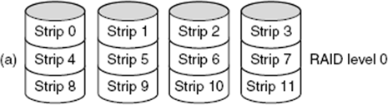
One disadvantage of RAID level 0 is that the reliability is
potentially worse than having SLED (Single Large Expensive Disk).

Slide 42
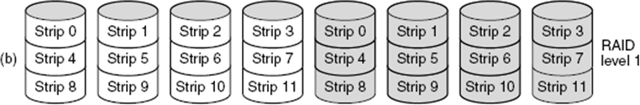
RAID level 1
• RAID level 1 is a true RAID.
• It duplicates all the disks, so in figure there are four primary disks and four backup disks.
• On a write operation every strip is written twice.
• On a read operation either copy can be used, distributing the load over more drives.
• Write performance is no better than for a single drive.
• Read performance is twice as good.
• Fault tolerance is excellent: if a drive crashes, a copy is simply used instead.
• Recovery consists of simply installing a new drive and copying the entire backup driveto it.

Slide 43
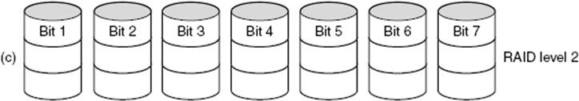
RAID level 2 works on word, possibly even a byte basis.
Imagine splitting each byte into a pair of 4-bit nibbles, then adding Hamming code toeach one to form a 7-bit word, of which bit 1, 2 and 4 were parity bits, as shown in figure below.
In this RAID level 2 each of seven drives needs synchronized in terms of arm position and rotational position, and then it would be possible to write the 7-bit Hamming coded word over the seven drives, one bit per drive.
Here, losing one drive did not cause problem, which can be handled by Hamming code on the fly.
But, on the down side this scheme requires all the drives to be rotationally synchronized and it also asks a lot of controller, since it must do a Hamming checksum every bit time.
•
43

Slide 44
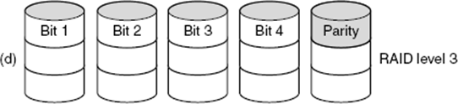
• RAID level 3 is simplified version of RAID level 2, as shown in the above figure.
• Here single parity bit is computed for each data word and written to a
parity drive.
• As in RAID level 2 the drives must be exactly synchronized.
• In case of drive crashing, it provides 1-bit error correction since position of each bad bitis known.

Slide 45
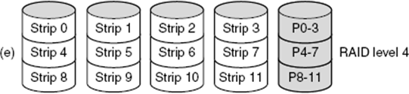
• RAID level 4 works with strips and not individual word with parity.
• They do not require synchronization of drives.
• As shown in the figure RAID level 4 is like RAID level 0, with strip-for-strip parity written onto an extra drive, for example, if each strip is k bytes long, all strips are EXCLUSIVE ORed together, resulting in a parity strip k bytes long.
• If a drive crashes, the lost bytes can be recomputed from the parity drive by
reading the entire set of drives.
• This design protects against the loss of a drive but performs poorly for small updates, if one sector is changed, it is necessary to read all the drives in order to recalculate the parity.
• It creates heavy load on parity drive.

Slide 46
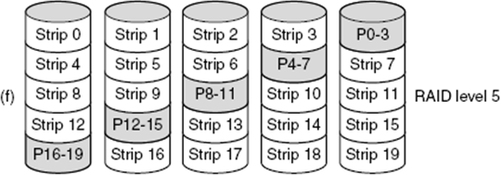
• As with RAID level 4, there is a heavy load in the parity drive, it may become bottleneck.
• This bottleneck can be eliminated in RAID level 5 by distributing the parity bits uniformly over all the drives, round robin fashion, as shown in the above figure.
• In the event of drive crash, reconstructing the contents of the failed drive is complex process.

Slide 47


